Slide 1
Cute Fractal
Guest Walkthrough

Slide 2
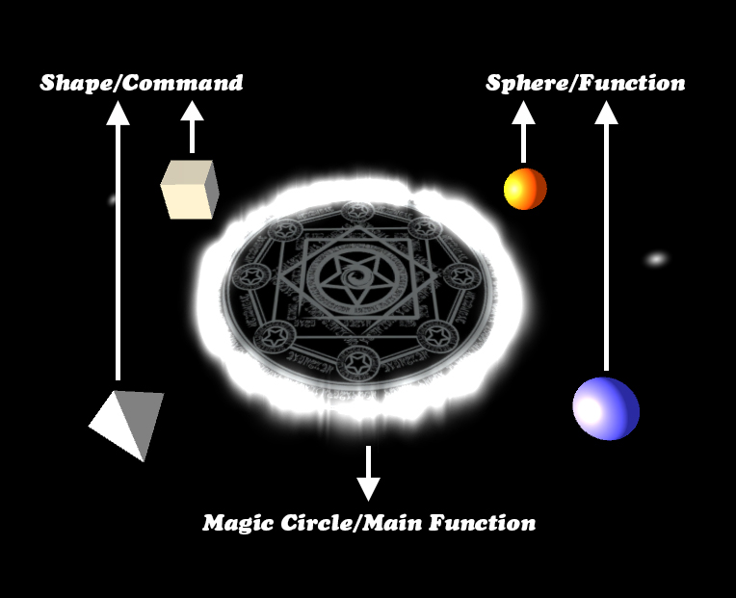
Define

Slide 3
Define
The magic circle represents the main function.
This is what describe your fractal. You can grab a magic out of it and release the magic to create fractals.
The spheres(blue and orange) represent functions.
As they are functions, you can define them, and you can use them to define other functions as well.
The shapes(triangle pyramid and cube) represent commands.
You can use them to define functions.
Each of them describes a new layer of shapes on the fractal.

Slide 4
Gesture
Grab:
When you put your right hand close enough to any object(magic circle/ shapes/ spheres), a golden circle will appear on the object. Now you can press and hold your right index finger to grab an instance of the shape and hold it in your hand. If you grab from the magic circle, you can get a magic.
Then you can release it by release your right index finger.
If you release a function or a shape to a function, you will add a new command to the function. If you release a magic, you will create the fractal you define at the place you release. If you release something not a magic in the air, it will directly disappear.
Cancel:
When you put your left hand close enough to any function(magic circle/ spheres), a red circle will appear on the object. Now you can press your left index finger to clean that function.
Remove Fractal:
Whenever you put any hand close to the fractal you created, you can press the joystick to remove the fractal.

Slide 5
Walkthrough – Step1
Ready with your Oculus headset and Oculus touch.
(Hold both touches while playing! Otherwise button press will not work!)
Start the prototype.
Move to a proper place and face a proper direction so you can see this whole scene in front of you.

Slide 6
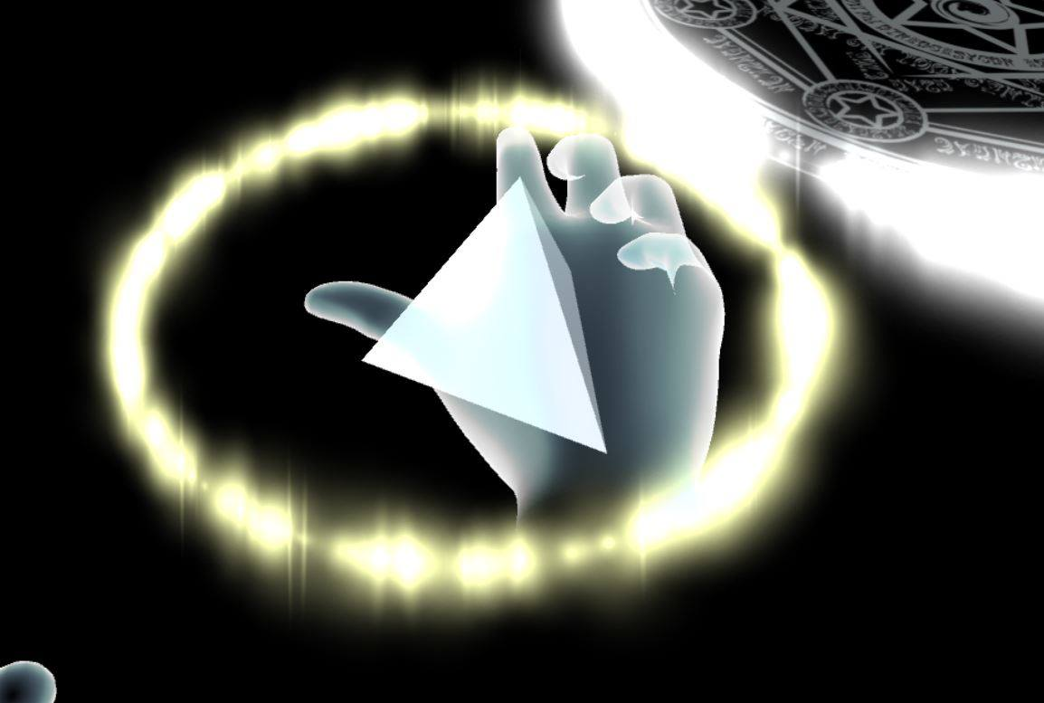
Walkthrough – Step2.1
Now let’s try to put a triangle pyramid into our magic circle.
1. Move your right hand close to the pyramid until you see a golden circle.

Slide 7
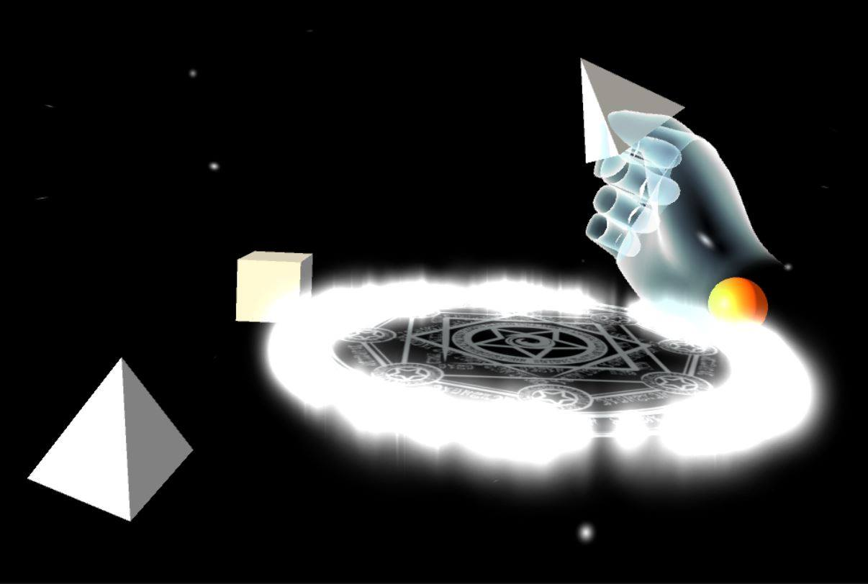
Walkthrough – Step2.2
2. Press and hold your right index finger, then you will hold an instance of the triangle pyramid in your right hand.

Slide 8
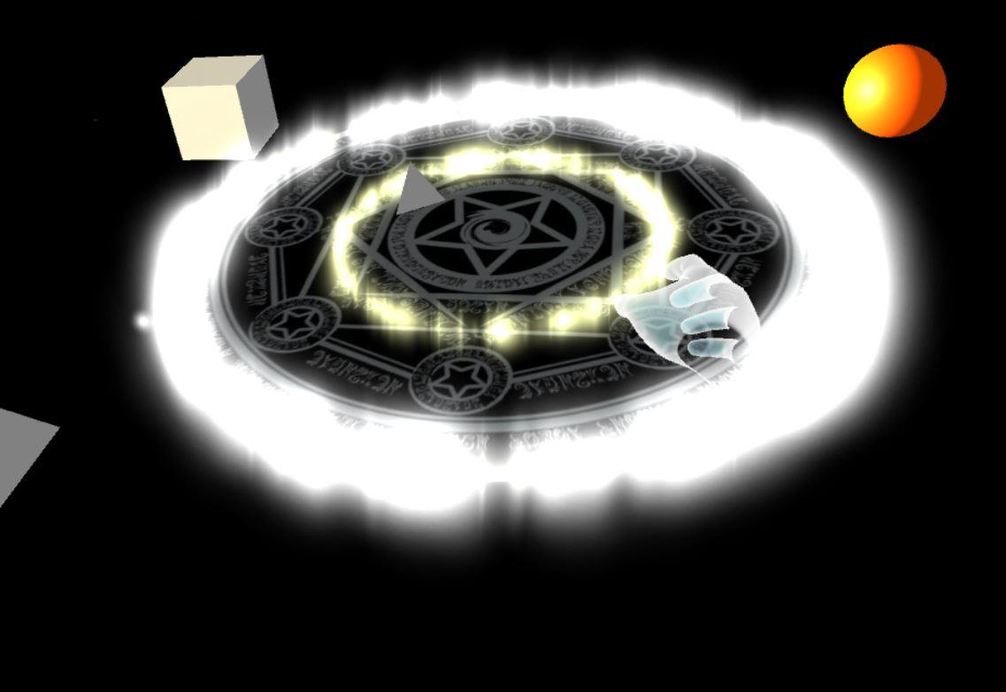
Walkthrough – Step2.3
3. Put your right hand close to the magic circle until you see a golden circle and release your right index finger.
Then if you see a small triangle pyramid spin on the magic circle, you successfully put a triangle pyramid into the magic circle.

Slide 9
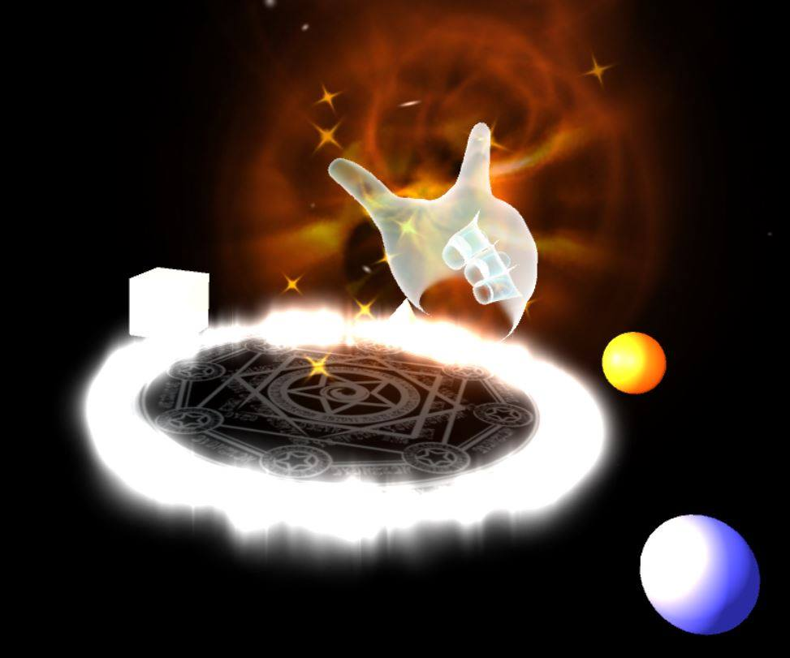
Walkthrough – Step3.1
Now let’s try to create a fractal.
1. Try to grab from the magic circle just like you grab from the triangle pyramid. You can get a magic out of it.
(Move right hand close to the magic circle until you see the golden circle, press and hold your index finger)

Slide 10
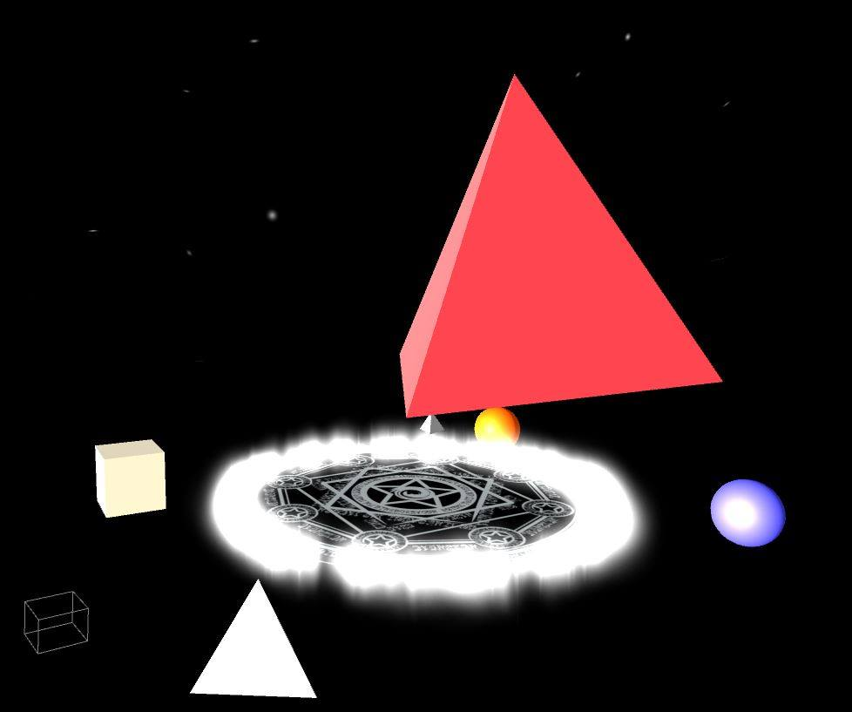
Walkthrough – Step3.2
2. Hold the magic and put your right hand to the place you want to create the fractal. Then release your right index finger.
If you create a pyramid, you just successfully created a fractal.

Slide 11
Walkthrough – Step4
Now let’s try to remove your fractal.
Press the joystick on any of your hand. Then the fractal you just created will be removed.

Slide 12
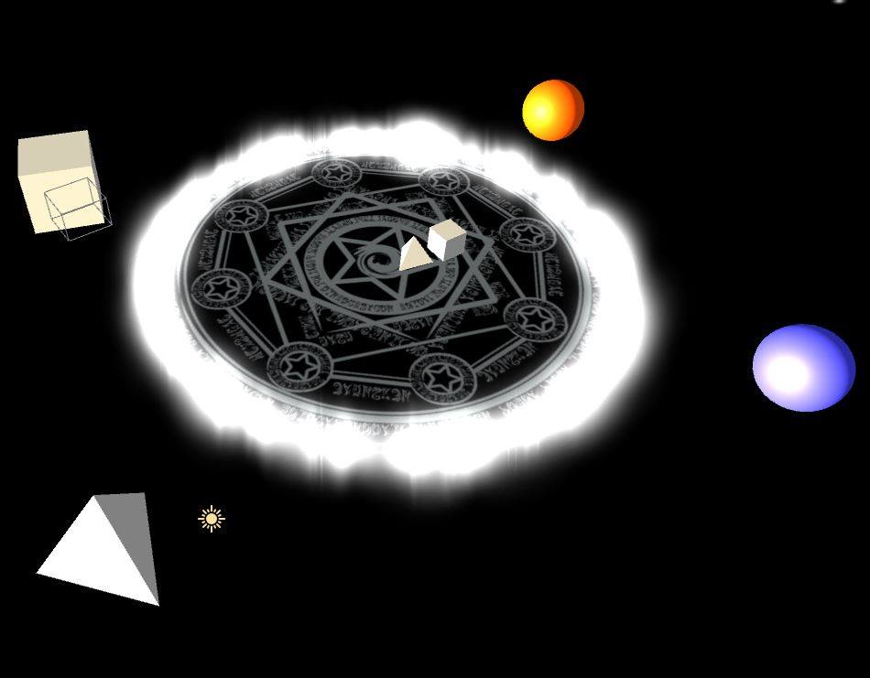
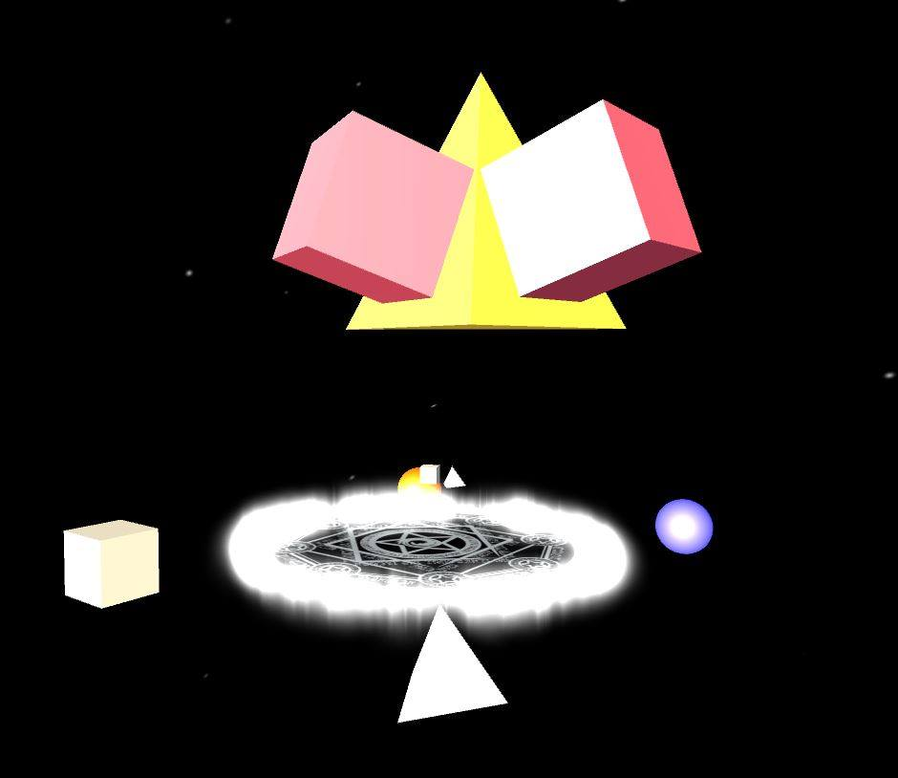
Walkthrough – Step5
Now let’s do a little more explore to better understand what these shapes are doing.
Try to add a cube into the magic circle just like you add the pyramid. Then create a fractal again.
New magic circle
New fractal

Slide 13
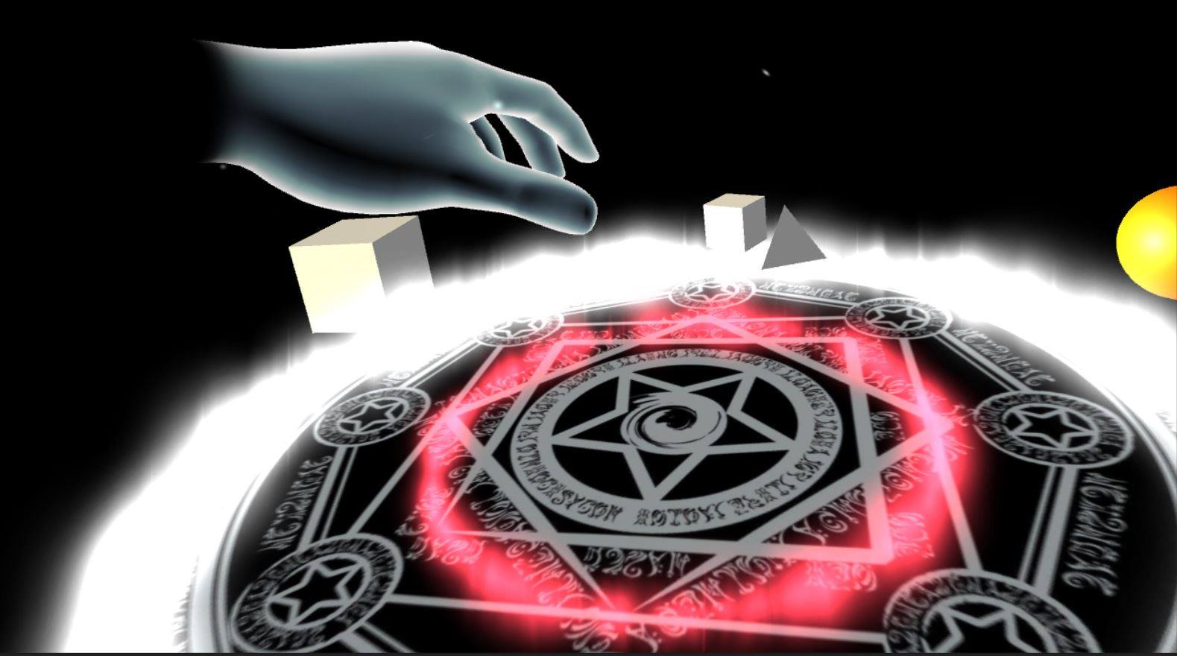
Walkthrough – Step6
Now let’s try to clean a defined function(sphere/magic circle).
Move your left hand close to the object you want to clean until you see a red circle, then press your left index finger.

Slide 14
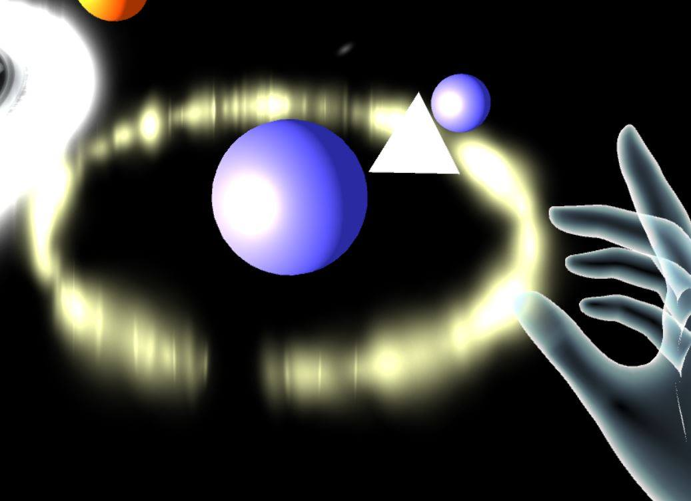
Walkthrough – Step7.1
Now let’s explore what we can do with the spheres.
1. Add a triangle pyramid into the blue sphere. Then grab a blue sphere and add it back to the blue sphere. You should get a blue sphere finally as below.

Slide 15
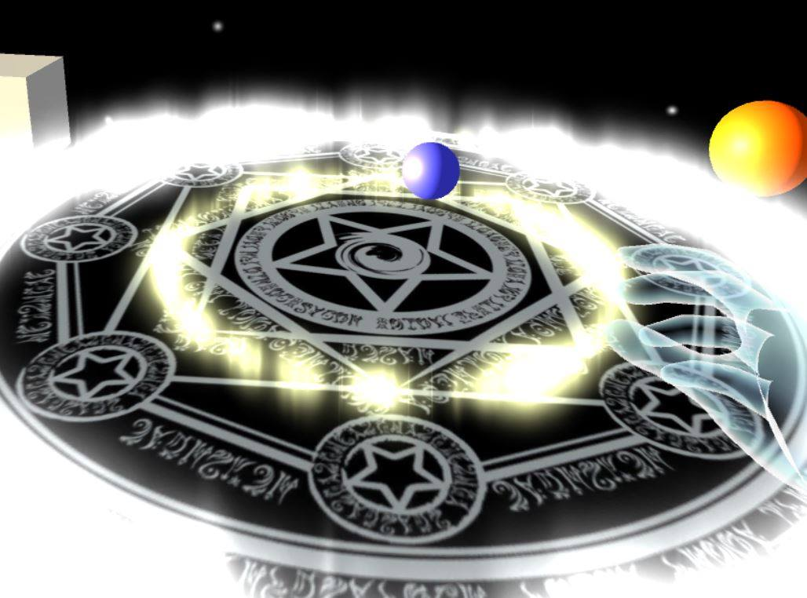
Walkthrough – Step7.2
2. Clean up the magic circle, then grab a blue sphere to the magic circle. You should have a magic circle as below.

Slide 16
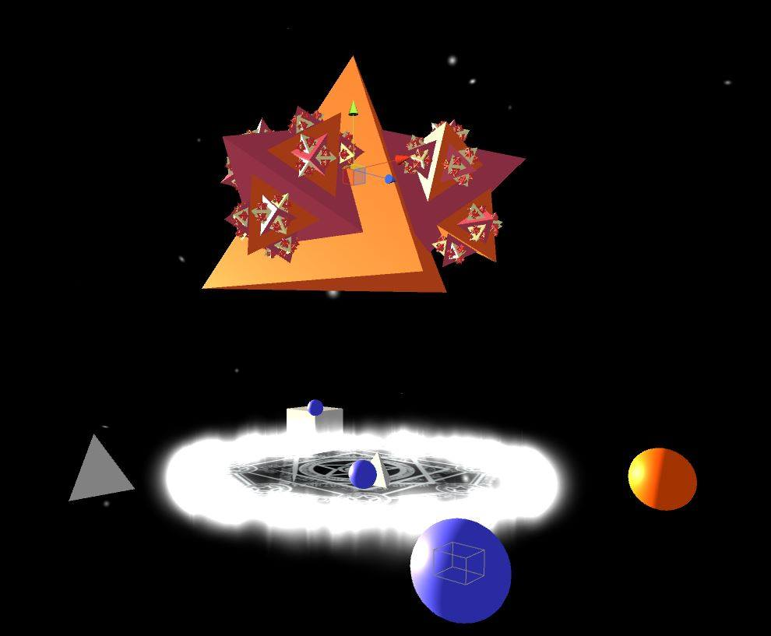
Walkthrough – Step7.3
3.Now if you create a fractal out of the magic circle, you should get a fractal construct with infinite triangle pyramid.

Slide 17
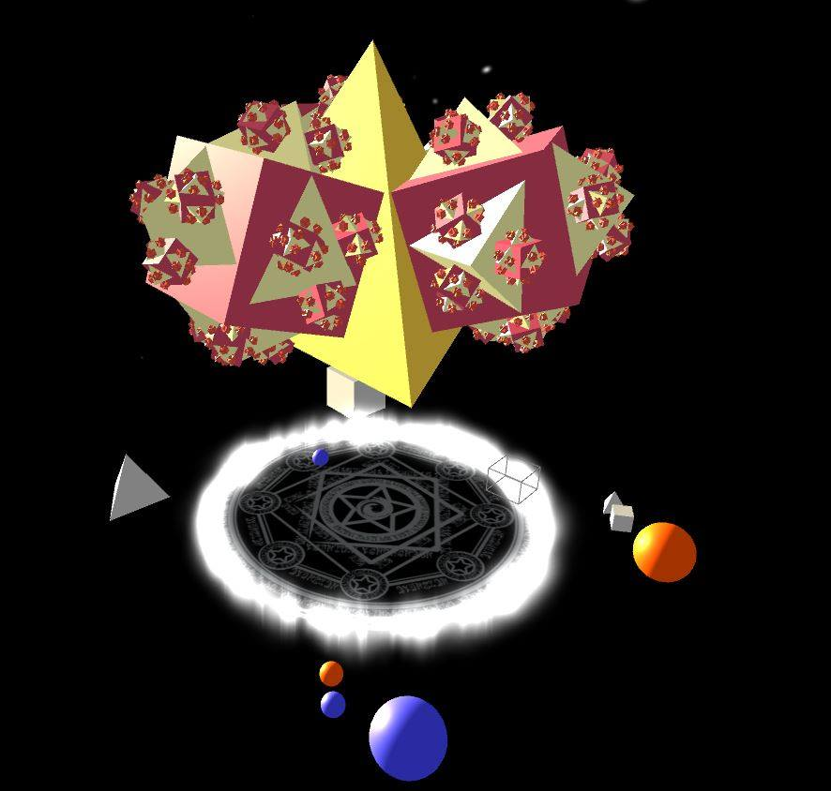
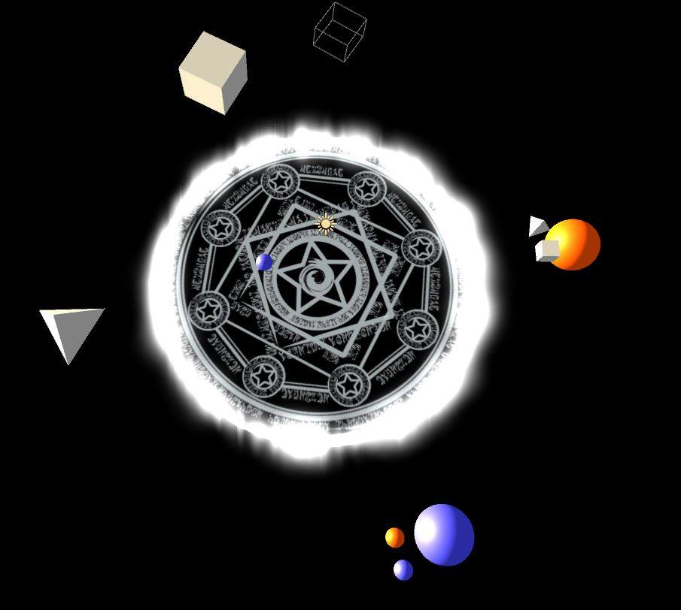
Walkthrough – Step8.1
The orange sphere function the same as the blue sphere, let’s do some more explore.
1.If we make the orange sphere to be a pyramid and then a cube; make the blue sphere to be a orange sphere and then a blue sphere; make the magic circle contains only a blue sphere, then you could be able to create a fractal as below.

Slide 18
Walkthrough – Step8.2
2. Similar to the one before, if we make the orange sphere to be a pyramid and then a cube; make the blue sphere to be a blue sphere and then a orange sphere; make the magic circle contains only a blue sphere, then you would create nothing.
Now when you try to create a fractal, it will start from magic circle, then try to simulate blue sphere. Next, the first step of the blue sphere is a blue sphere, we try to simulate blue sphere again. Then, this will keep repeat. So we will never arrive the orange sphere or get any shapes.
That is why when you release the magic, you will create nothing.

